Slide 1

Improving Inriver Chinook Salmon Estimates using acoustic tags on the Nushagak River
By Suzanne Maxwell, Greg Buck, and April Faulkner
Alaska Department of Fish and Game
Commercial Fisheries Division
Southcentral Region
This presentation was prepared under award NA09NMF4380373 from the National Oceanic and Atmospheric Administration (NOAA), U.S. Department of Commerce, administered by the Alaska Department of Fish and Game. In 2014, the research was partially funded by the Chinook Salmon Research Initiative (appropriation number 43106-18) for Project 11329046 (Nushagak Adult In-River Abundance). The statements, findings, conclusions, and recommendations are those of the authors and do not necessarily reflect the views of NOAA, the U.S. Department of Commerce, or the Alaska Department of Fish and Game.

Slide 2
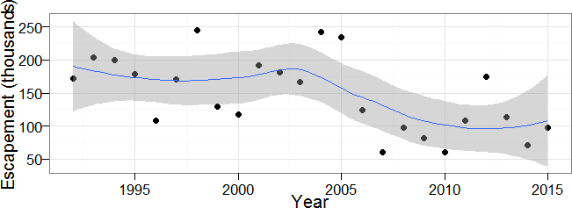
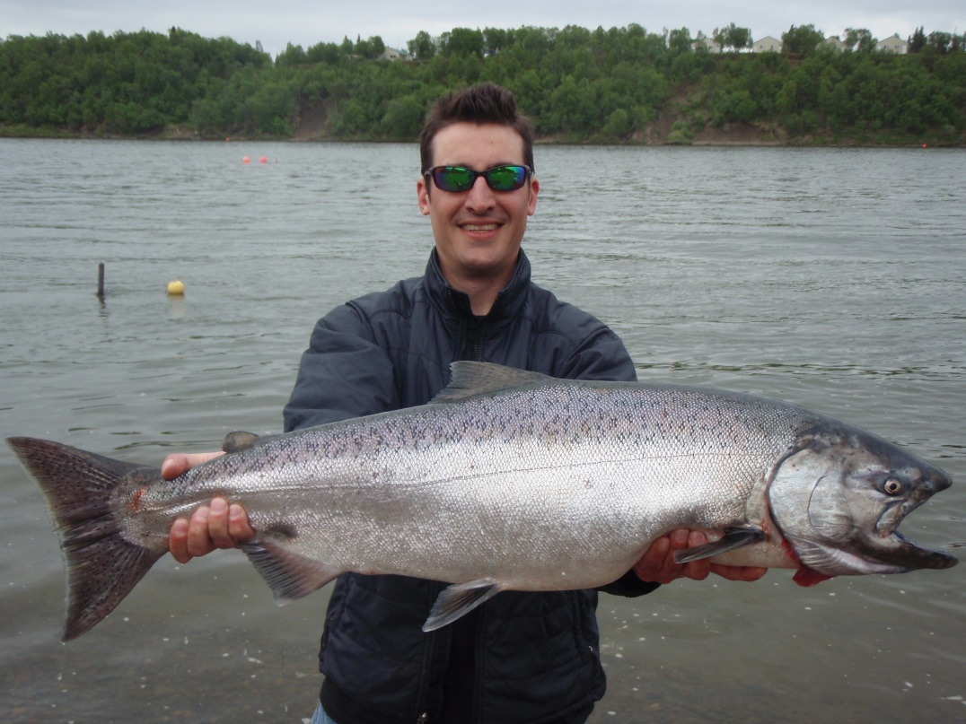
Nushagak River Chinook
Largest Chinook run in Bristol Bay
Average Escapement: 147,000
Roughly equal numbers of age-1.2, age-1.3 and age-1.4

Slide 3
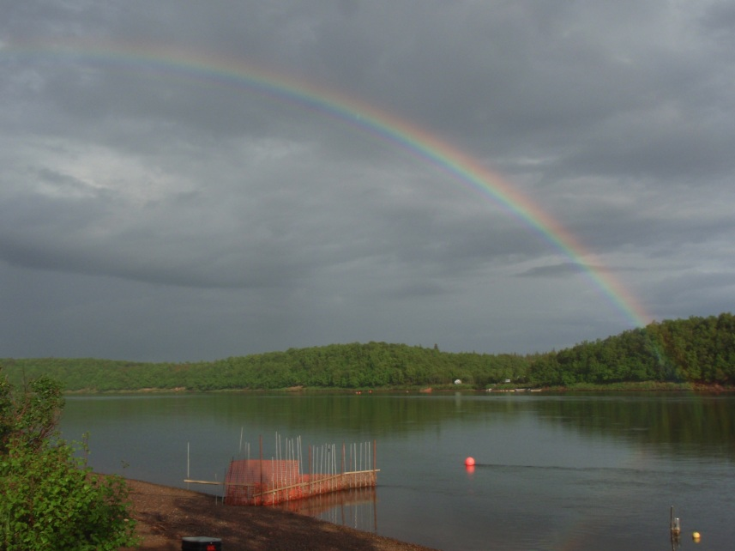
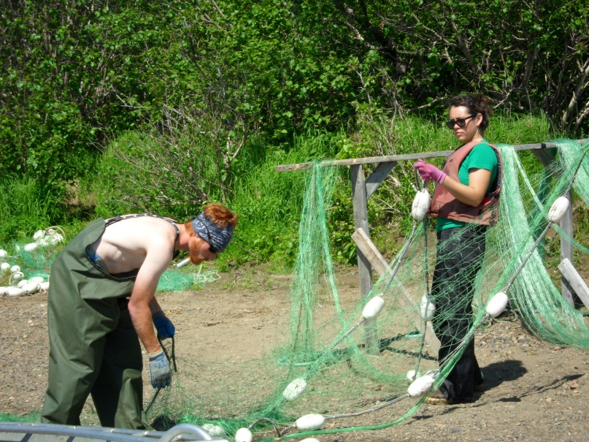
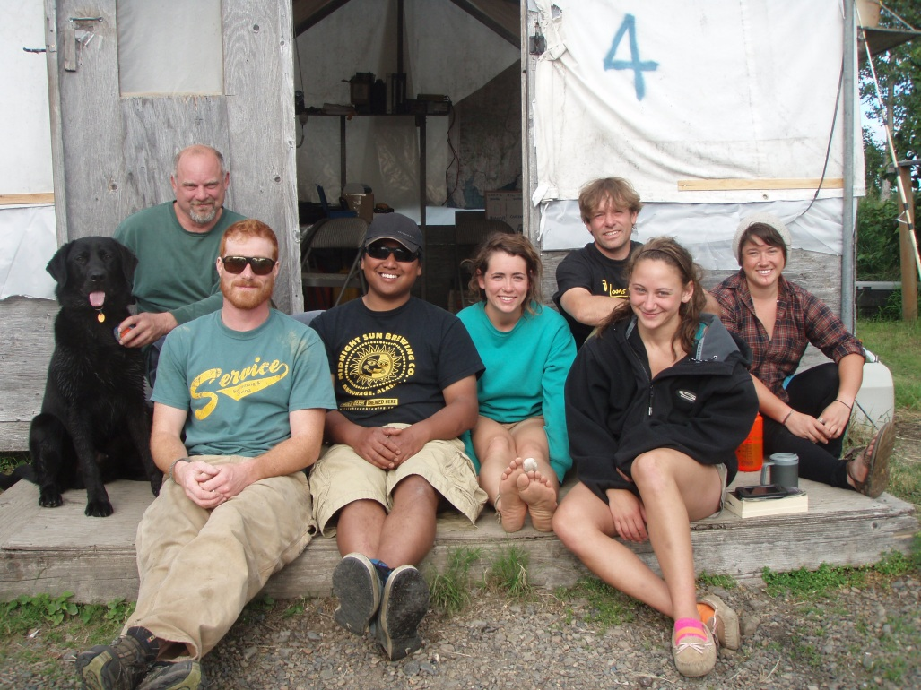
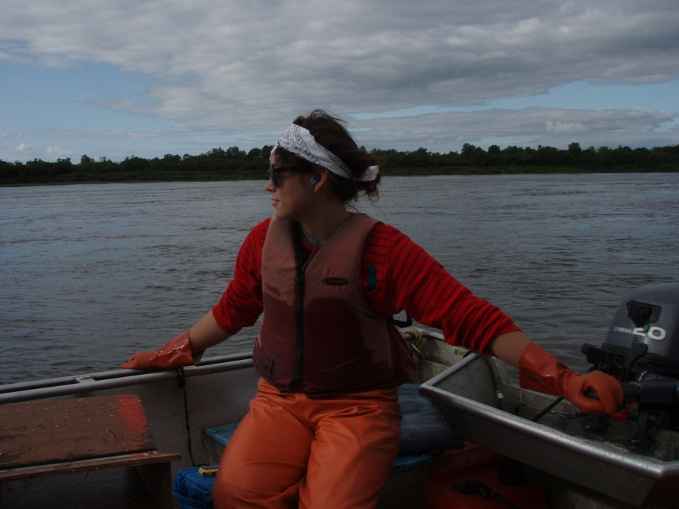
Sonar camp—nushagak river

Slide 4
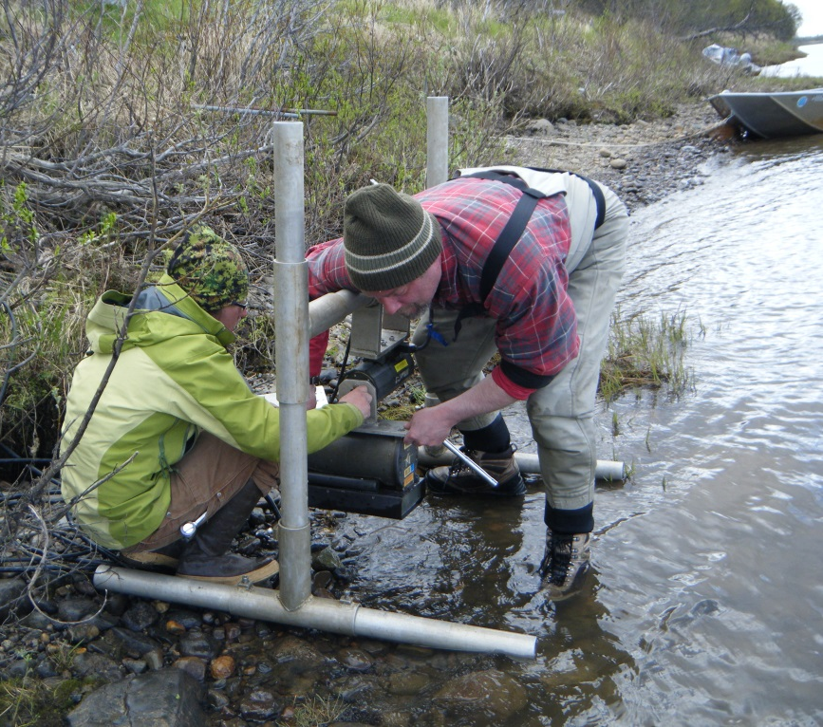
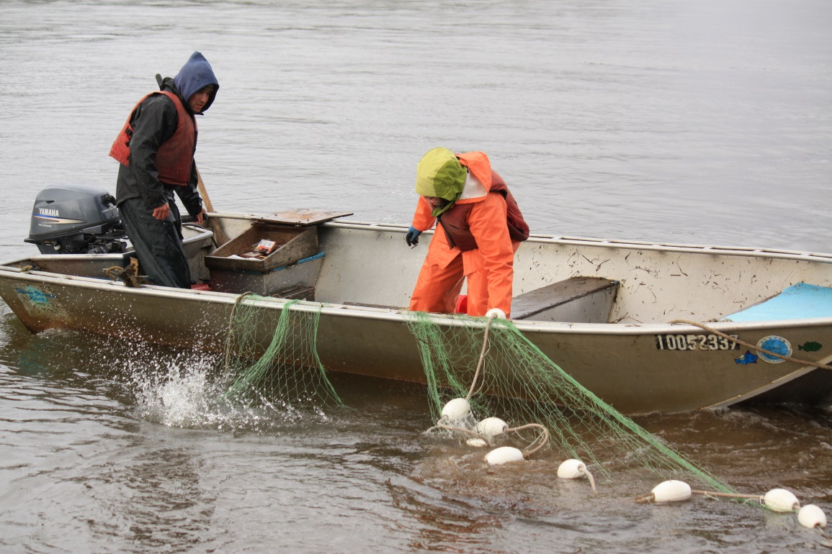
How Do We Assess Nushagak Chinook?
Sonar (DIDSON)
Drift Gillnetting

Slide 5
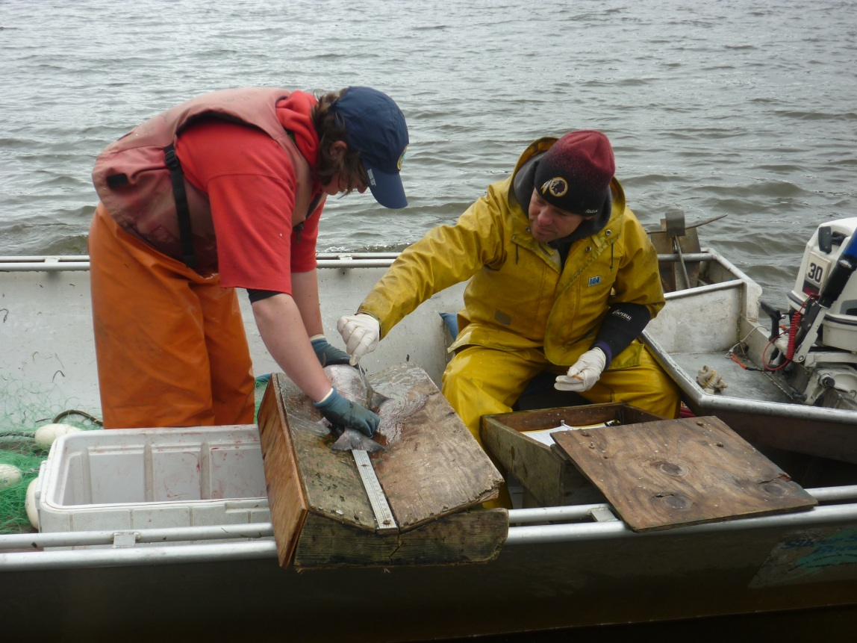
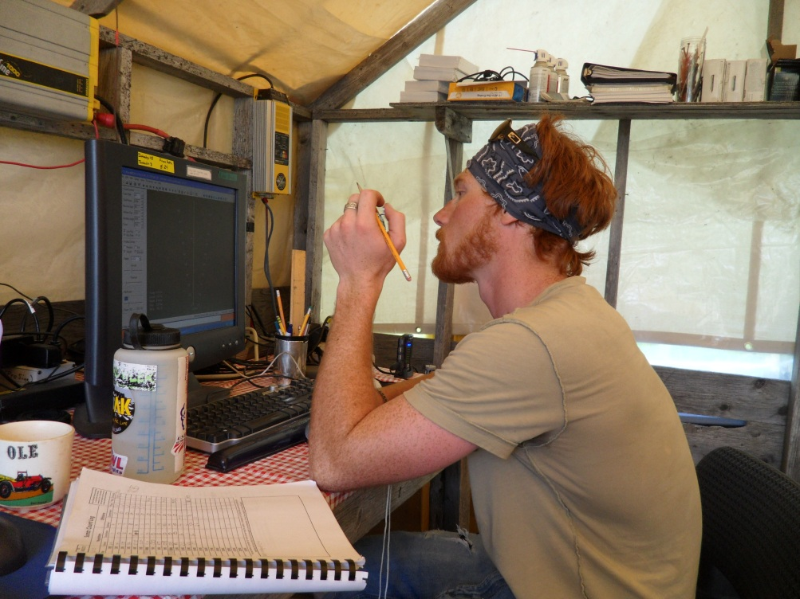
Counting and Measuring Fish

Slide 6
Why was a new Study needed?
Chinook salmon estimates considered an index, but the index may not be stable
Sonar project designed to assess shore-based sockeye salmon
Ensonifies only 1/3 of the 300-m wide river
Chinook salmon frequently captured offshore of the ensonified regions
An unknown proportion pass beyond the sampling range of the DIDSONs
Many factors may push Chinook salmon toward or away from shore causing instability in the annual index

Slide 7
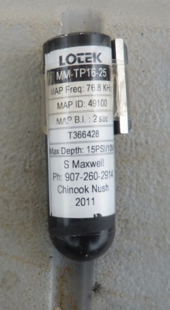
How can Acoustic Tags Help?
Acoustic tags allow us to track fish movements through the region of an array
Tags inserted into fish emit sound waves (pings)
An array of hydrophones (data loggers) detect the pings and use timing and data logger coordinates to triangulate fish location (i.e., the source of the pings)
16 mm diameter x 58 mm length
76 kHz carrier wave
2-s pulse interval
Each tag has a unique signal so individual tags can be identified by the hydrophones (data loggers)

Slide 8
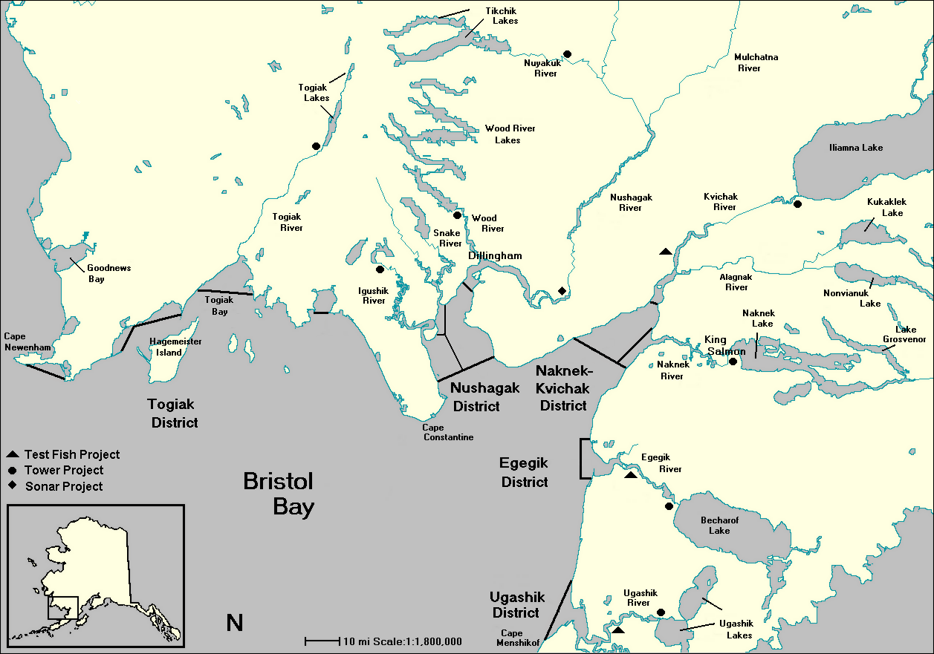
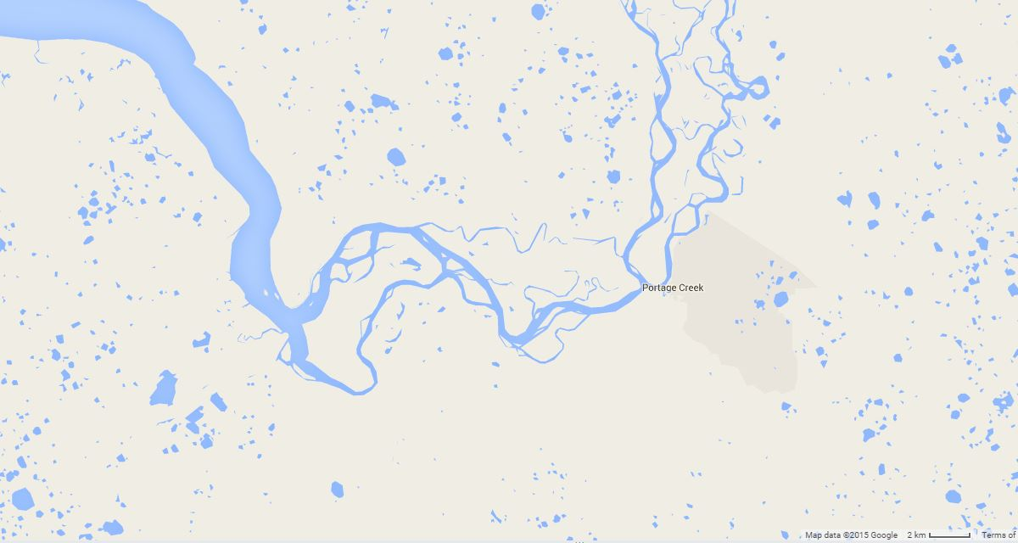
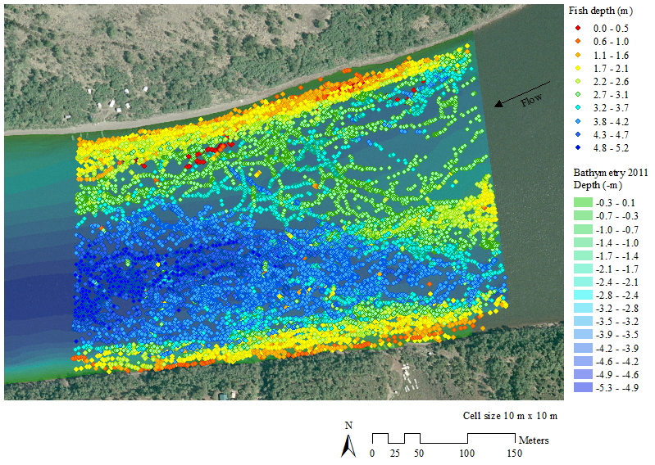
Where was the Study Located?
flow
Tag Insertion
Site 1
Tag Insertion
Site 2
Tag Detection Site (Sonar Site)
Sonar site is 13 km upriver from tag insertion site

Slide 9
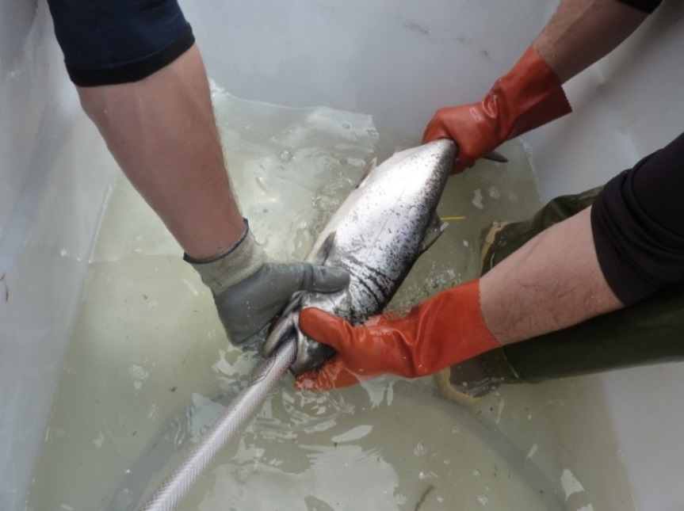
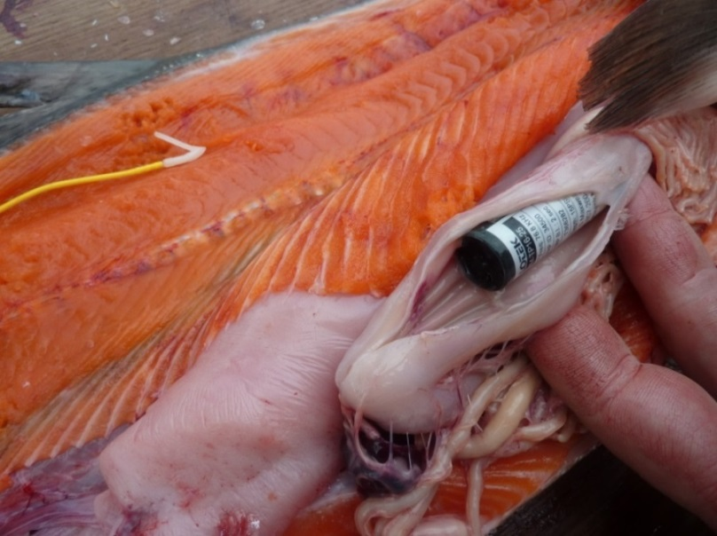
Inserting Tags
Fish captured in drift gillnets at the lower site
Nets pulled as soon as a fish was captured
Fish placed in live box
Age, length, sex data collected and tag inserted using long plastic pipe

Slide 10
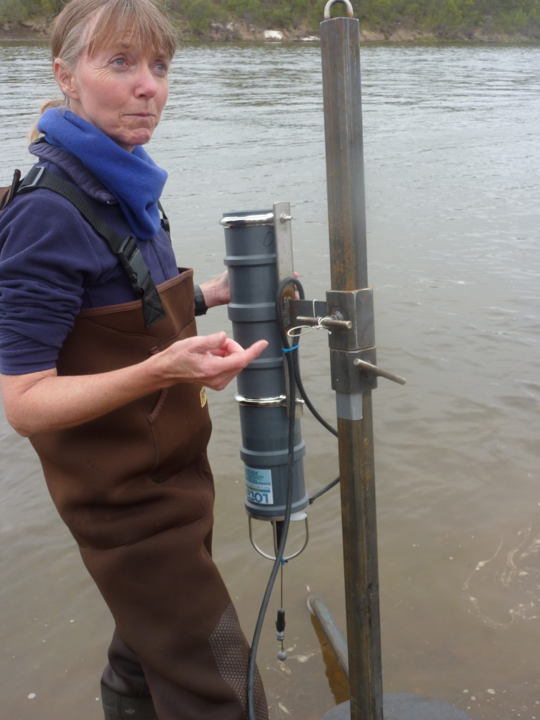
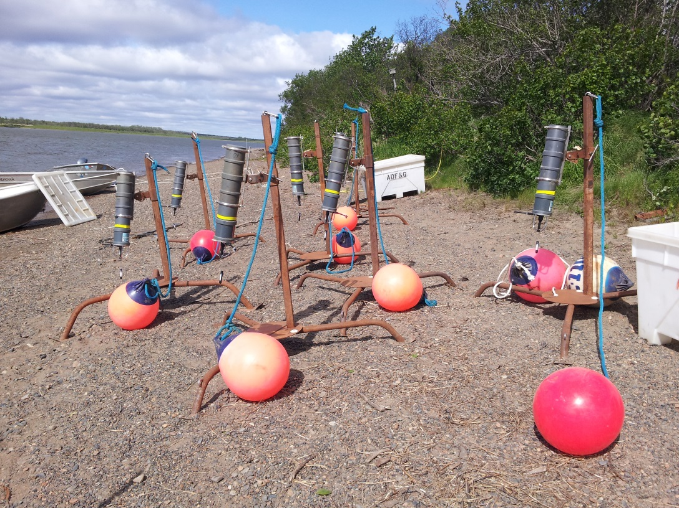
Assembling the tripods

Slide 11
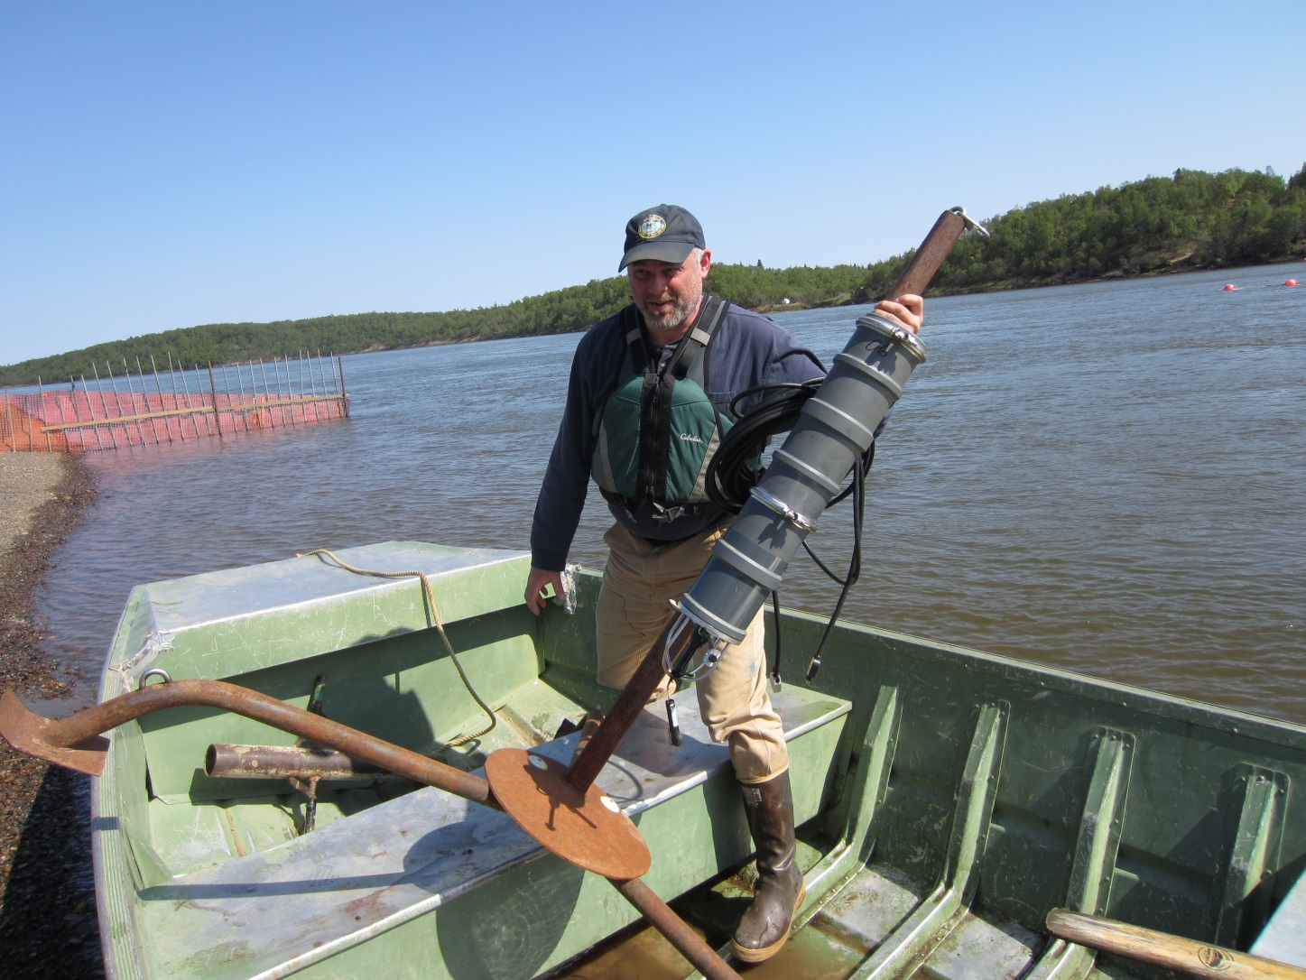
man-handling the Tripod

Slide 12
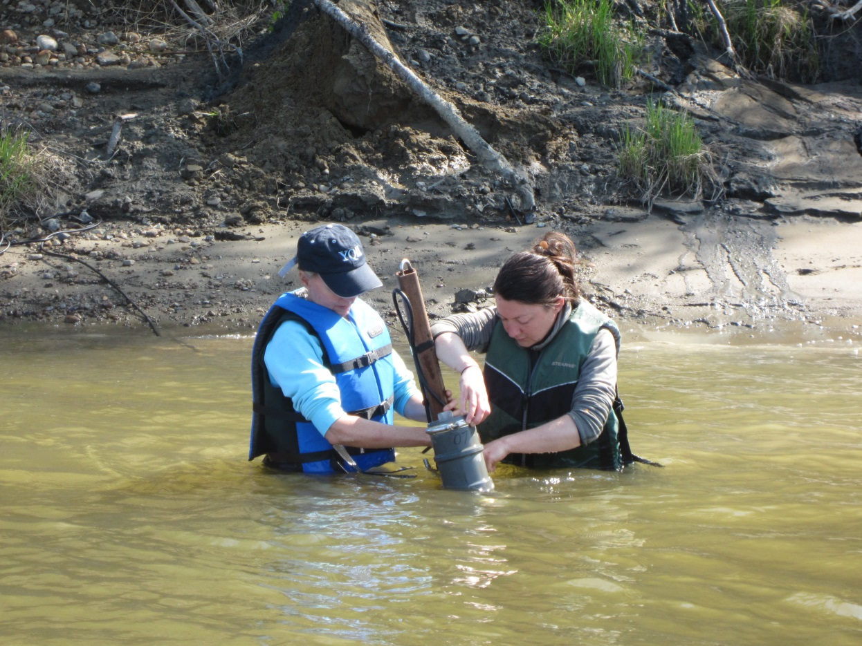
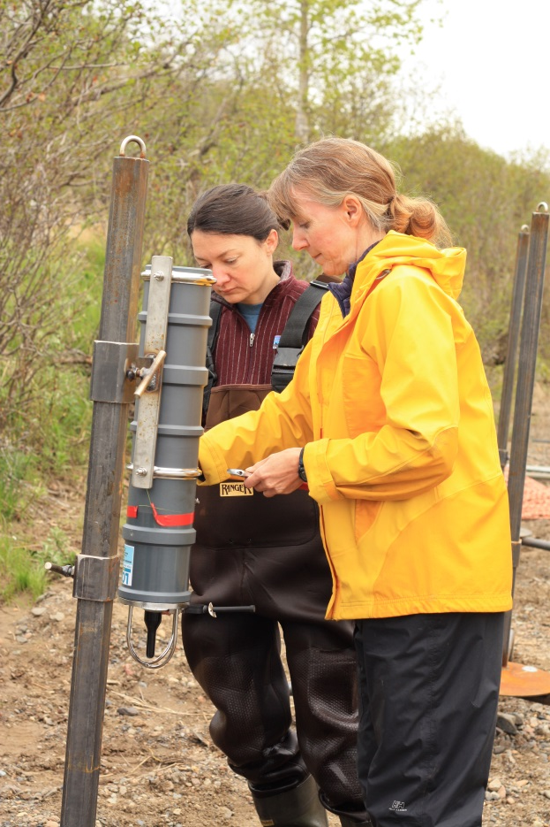
Setting Up the Array
Array deployed at the sonar site with tripods placed on either side of the river

Slide 13
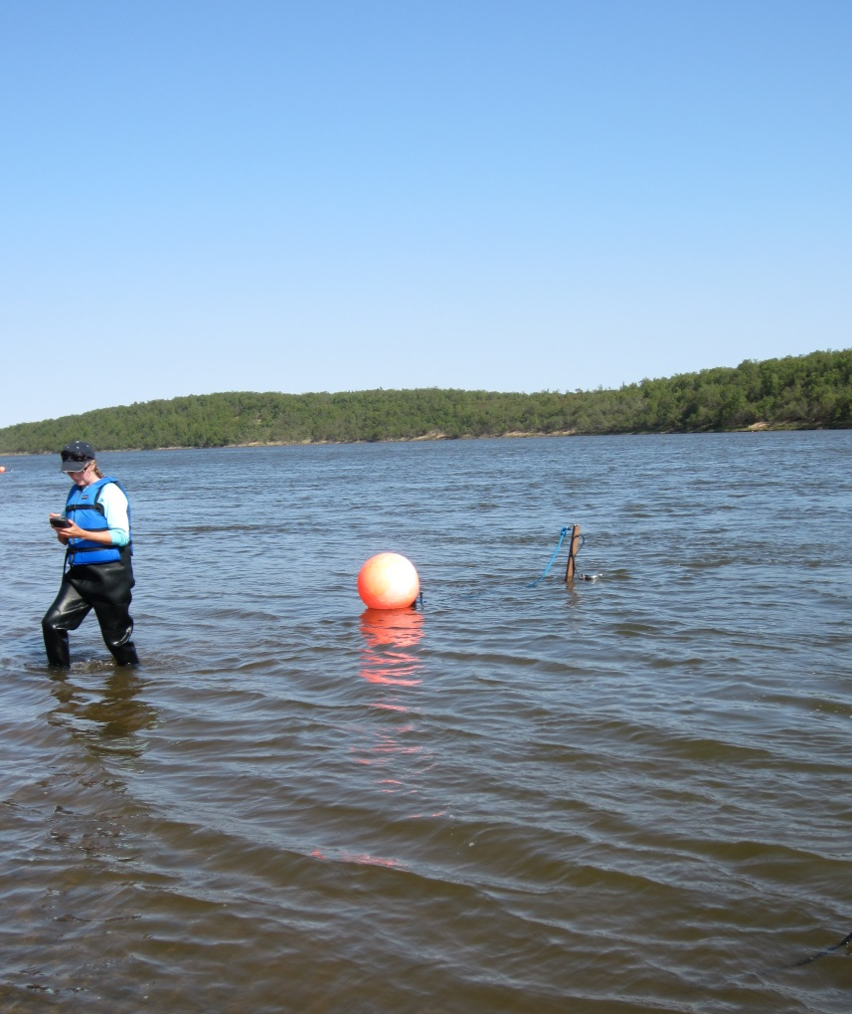
A successful deployment

Slide 14
Processing Data
Data loggers detect pings and store data
Data downloaded to raw files
Raw data run through proprietary software (ALPS and U-Map from Lotek, Inc.) to produce position estimates of detected pings
Position estimates filtered
Fish tracks plotted
Track positions compared with sonar-beam footprints to determine whether the fish passed through the sonar beam

Slide 15
Tag Stats
Event | No. | %³
Tags inserted into Chinook salmon | 799 | 100.0
Tags detected¹ | 756 | 94.6
Tags with position estimates² | 654 | 81.9
Tags remaining after filtering | 613 | 76.7
Mortalities during capture | 2 | 0.3
Recaptured at sonar site | 1 | 0.1
Recaptured by sport fishermen | 4 | 0.5
Single-trip fish | 511 | 64.0
Multiple-trip fish | 99 | 12.4
¹ Detected by one or more DLs (Lotek, Inc.'s WHS Reader software)
² Position estimates output by ALPS or U-Map (Lotek, Inc.'s Asynchronous Logging Positioning Software)
³ Percent of inserted tags

Slide 16
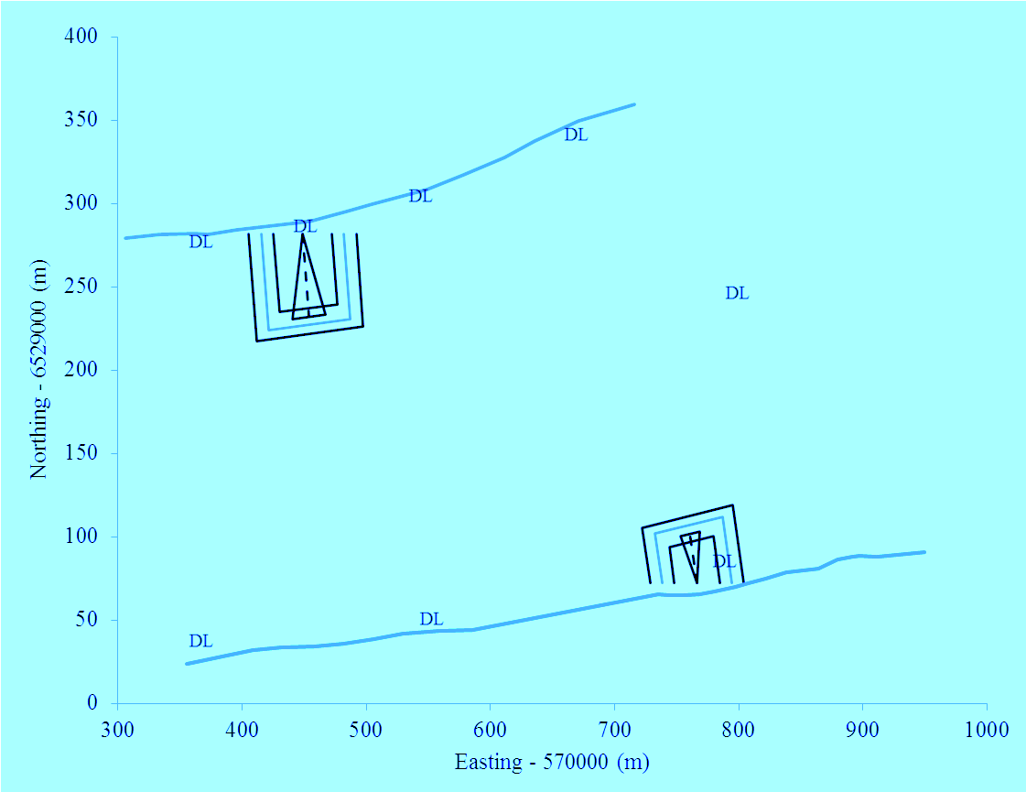
Array Layout and Probability Regions
Shoreline
p=1
Data Logger
p=0.5
p=0.25
Flow
Left bank

Slide 17
Fish Tracks (filtered)
Flow
Dark to light coloring on fish track indicates the fish is moving upriver

Slide 21
Multiple-Trip Fish
7 d later
Notes:
Fish 416, a 2-trip fish that traveled upriver along the left bank, returned 7 d later along left bank, where it held for a period of time before crossing the river and looping between right bank and the river’s center. No additional upriver trip was observed, so it was assumed the fish moved downriver and did not return.

Slide 22
4 d later
2 d later
Mult-trip Fish (3 trips)
T1 – large looping track as fish moves upriver
T2 – returned 4 days later heading downriver
T3 – 2 days later traveled upriver with detection lost prior to reaching the left bank sonar
Notes:
Fish 332, a 3-trip fish that created a large looping track in its first trip (A), returned 4 d later heading downriver (B), and then 2 d later traveled upriver along left bank with detection lost prior to reaching left bank (C).

Slide 23
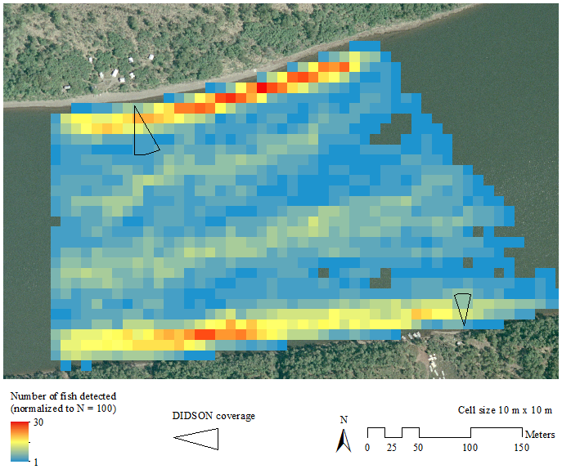
Preferred Travel Lanes - 2011

Slide 24
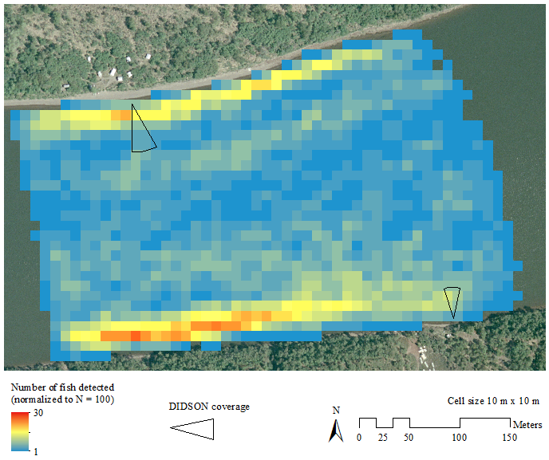
Preferred Travel Lanes - 2012

Slide 25
Preferred Travel Lanes - 2013

Slide 26
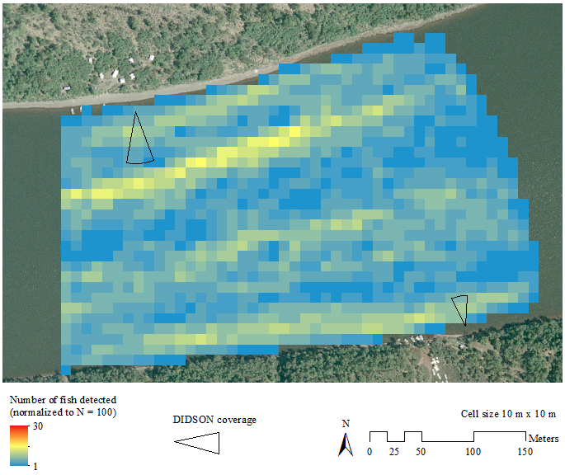
Preferred Travel Lanes - 2014

Slide 27
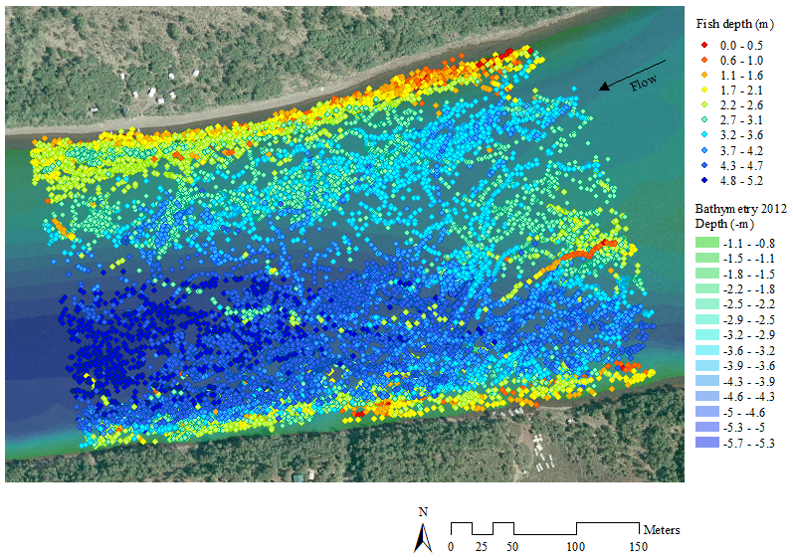
Fish Depth: Upriver-Moving Fish
2012

Slide 28
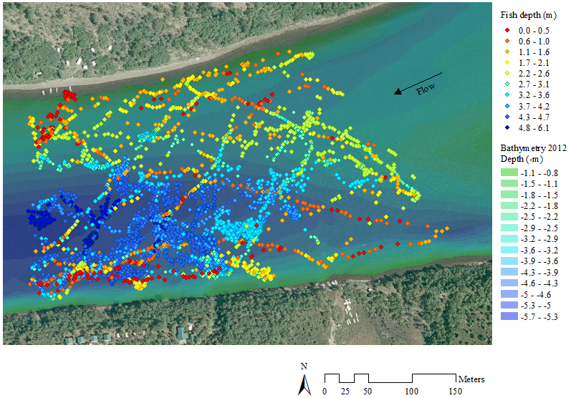
Fish Depth: Downriver-moving Fish
2013

Slide 29
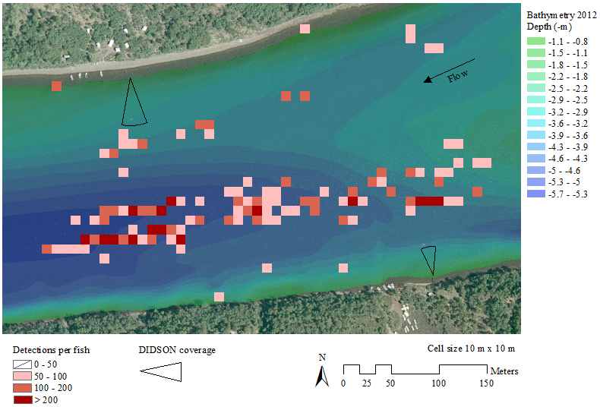
Fish Holding Regions
2014

Slide 30
results
 | 2011 | 2012 | 2013 | 2014 | Average²
No. of tagged fish¹ (n) | 124 | 150 | 137 | 202 | 153
Tagged fish proportion that traveled through a sonar-beam footprint | 0.63 | 0.55 | 0.63 | 0.42 | 0.56
SE | 0.044 | 0.041 | 0.041 | 0.035 | 0.020
Sonar estimates by year (DIDSON) | 108,278 | 174,085 | 113,709 | 70,482 | 116,639
SE | 4,687 | 8,604 | 6,423 | 6,778 | 3,384
Expanded Sonar Estimates | 171,950 | 317,481 | 180,616 | 167,007 | 209,264
SE | 11,878 | 23,577 | 11,861 | 13,724 | 8,008
Difference (Expanded - Sonar) | 63,672 | 143,396 | 66,907 | 96,525 | 92,625
¹ Includes only filtered fish tracks; incoherent tracks were removed from the dataset
² SE values in this column are not averages, they are the SE for all years

Slide 31
Bank Ratios
Tagged fish bank ratios more stable than DIDSON ratios
Year | DIDSON % by bank |  | Tagged fish % by bank
 | Right | Left | Right | Left
2011 | 40 | 60 | 59 | 41
2012 | 24 | 76 | 58 | 42
2013 | 36 | 64 | 54 | 46
2014 | 41 | 59 | 55 | 45
Average | 35 | 65 | 57 | 43
¹ Tagged fish percentages only include tagged fish that traveled through a DIDSON footprint

Slide 32
Conclusions
56% of tagged fish (on average) passed through the beam footprints
This proportion relatively stable from 2011-2013, but lower in 2014
Chinook salmon use entire river when migrating past the sonar site
Tagged fish bank ratios relatively stable between years, DIDSON bank ratios more variable
DIDSON bank ratio higher on left bank, tagged fish ratio higher on right bank

Slide 33

What’s Next?
Discuss Improvements to Nushagak Chinook Escapement Estimate
expand count based on this study
modify sonar site to better assess Chinook salmon
Further analysis:
Effect of age on movement patterns
Effect of river density on movement patterns
Effect of environmental factors (temp, tide, time etc) on movement pattersn

